Slide 1
Year 7 Biology
Area | Big Idea | Year 7
Organisms | Cells are alive | Cells Cell structure Specialised cells – Engage slide
 | Bodies are systems
Ecosystems | Organisms are interdependent | Interdependence Feeding relationships – Engage slide Competition Abiotic & biotic factors
 | Ecosystems recycle resources
Genes | Characteristics are Inherited | Reproduction Sexual & asexual Menstrual cycle – Engage slide Embryo development
 | Species show variation
More details masteryscience.com © masteryscience 2019

Slide 2
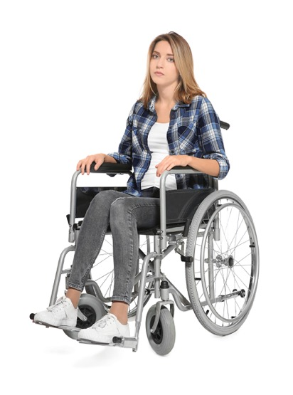
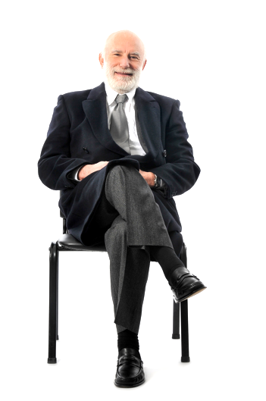
It’s 2042 and you work in the new science of cell therapy.
Specialised cells
“
“
“
I can’t have children
My spinal cord was broken in an accident
My heart was damaged in a heart attack
“
“
“
ENGAGE
What will you do to help your patients?
SPECIALISED CELLS > ACQUIRE
© Mastery Science, 2018
Notes:
They meet three new patients and are asked what they will do to help them

Slide 3
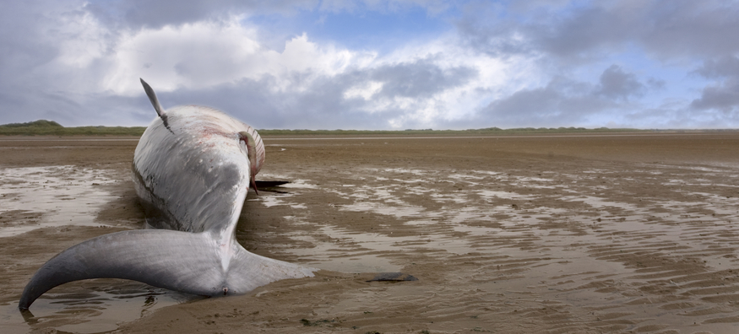
Pills can kill
Omega-3 in fish oil may be good for your brain. But making it is reducing the number of killer whales.
Feeding relationships
Fish oil pills are often made from krill, tiny creatures that live in the Antarctic. Killer whales don’t eat krill, but other animals do. Stop buying the pills and leave krill in the ocean!
Watch amazing whales
It doesn’t make sense! If the killer whales don’t eat krill, how can removing krill affect them?
Luke
ENGAGE
Is the claim about fish oil pills correct?
FEEDING RELATIONSHIPS > ACQUIRE
© Mastery Science, 2018
Notes:
The stimulus is shown. Click on the link to play a video introducing a talking killer whale!
The task is set – to investigate the claim that taking fish oil pills reduces the number of killer whales. Ask students for their initial ideas.

Slide 4
“
This app is amazing!
It will help me to get pregnant.
Menstrual cycle
“
Today
fertile
If you have sex today, there is a high chance of pregnancy
ENGAGE
How can an app tell if a woman is fertile?
MENSTRUAL CYCLE > ACQUIRE
© Mastery Science, 2018
Notes:
Display the stimulus and the engage question.

Slide 5
Year 7 Physics
Area | Big Idea | Year 7
Forces | Forces predict motion | Contact forces Balanced or unbalanced Friction – Engage slide Density
 | Fields produce forces | Gravity Weight Gravitational force - Engage slide Solar system
Energy | Energy is conserved | Energy transfers Energy Wasted energy – Engage slide Heat & temperature
 | Electricity transfers energy | Electric circuits Electric current Resistance – Engage slide
 | Radiation transfers energy
More details masteryscience.com © masteryscience 2019

Slide 6
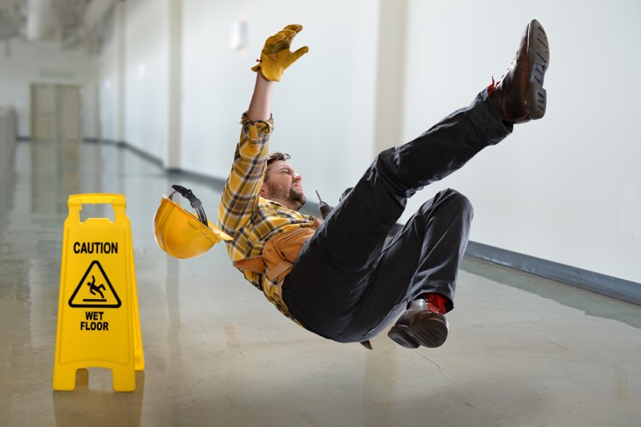
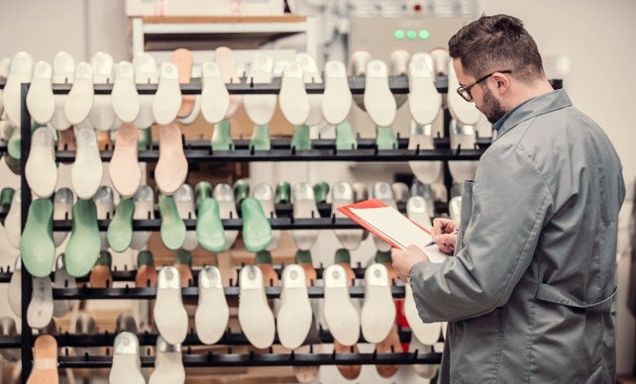
Each year, 250,000 people in the UK go to hospital after a fall. Wet surfaces increases the risk.
Friction
Engineers can reduce the number of falls by designing soles that don’t slip.
ENGAGE
What’s the best sole for wet conditions?
FRICTION > ACQUIRE 1
© Mastery Science, 2018
Notes:
Introduction to the lesson is shown with engage question. Discuss with the class why people are more likely to fall in wet conditions. Listen to the terminology they use i.e. the ground is more slippery, less grip from shoes. Ask them what they think the properties of the sole should be.

Slide 7
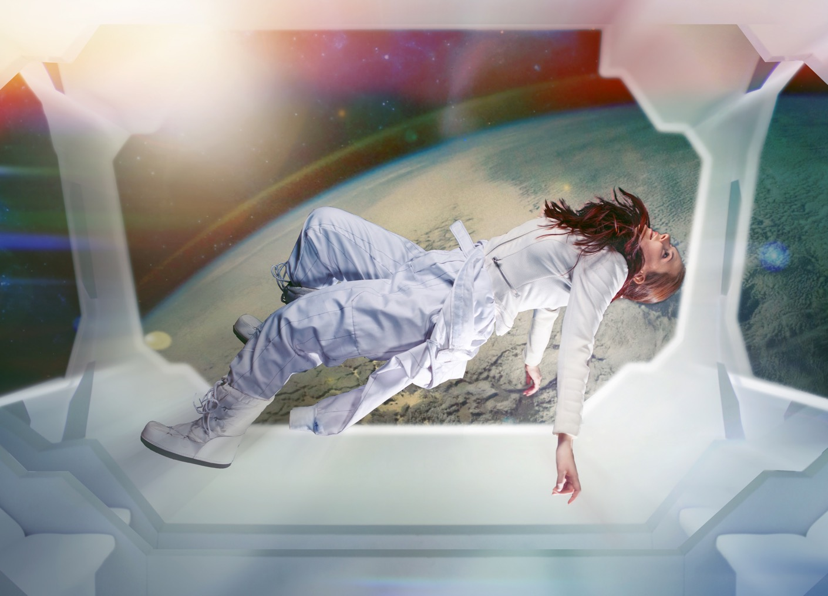
Join us for a 12 day space holiday.
Amazing views of planet Earth.
Gravitational force
Experience being weightless
ENGAGE
How can you feel weightless near Earth?
GRAVITATIONAL FORCE > ACQUIRE
© Mastery Science, 2018
Notes:
Sets the task – the students will be explaining why people will be weightless whilst in orbit around Earth. Ask them for their initial ideas – a common misconception that there is no gravity.

Slide 8
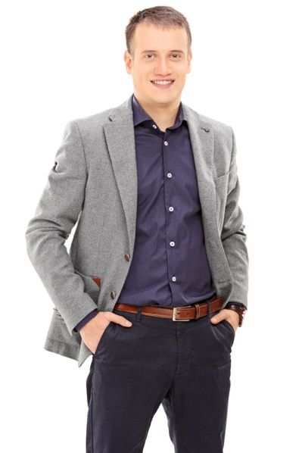
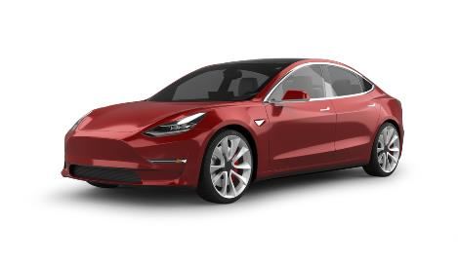
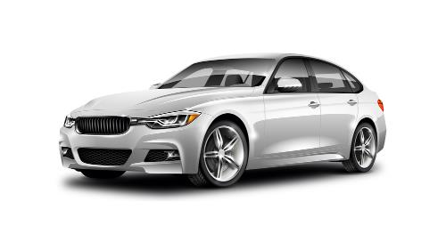
“
Wasted energy
Electric cars are less polluting than petrol …
...but what we really want to know is - will they save me money?
Help me find out…
“
electric
petrol
ENGAGE
How far will each car go on £1?
© Mastery Science, 2019

Slide 9
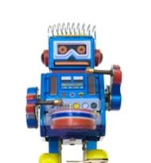
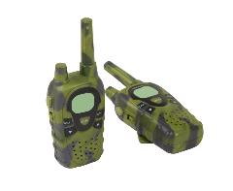
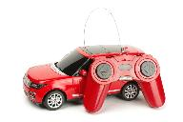
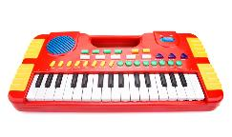
You work for an electronic toy company.
“
Resistance
I’ve got the designs for our new range of toys. Can you make their circuits work?
“
ENGAGE
Can you design the circuits?
© Mastery Science, 2019
Notes:
The students are in role working for an electronic toy company.

Slide 10
Year 7 Chemistry
Area | Big Idea | Year 7
Matter | Structure determines properties | Substances & particles Particle model Mixtures – Engage slide Solutions
 | Reactions rearrange matter | Changing substances Chemical & physical pH scale – Engage slide Neutralisation
 | Earth systems interact
More details masteryscience.com © masteryscience 2019

Slide 11
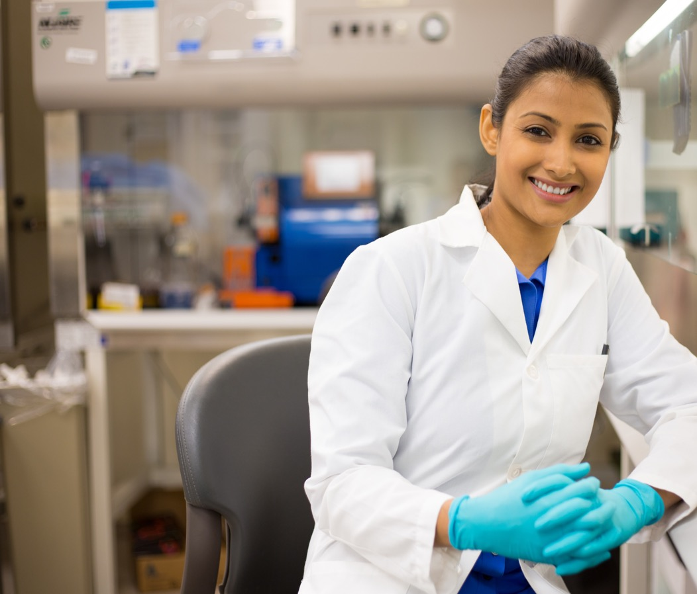
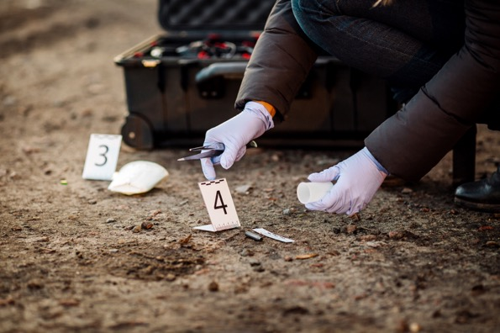
Welcome to forensic scientist training
Mixtures
“
I analyse substances found at crime scenes.
But they’re often mixed together. Your assignment is to help me separate them.
“
ENGAGE
How do scientists make pure samples?
MIXTURES > ACQUIRE
© Mastery Science, 2018
Notes:
For this activity students are in role as trainee forensic scientists. Display their training assignment and the engage question. Discuss with the class how a forensic scientist helps to solve crimes, what kinds of evidence might they need to analyse?

Slide 12
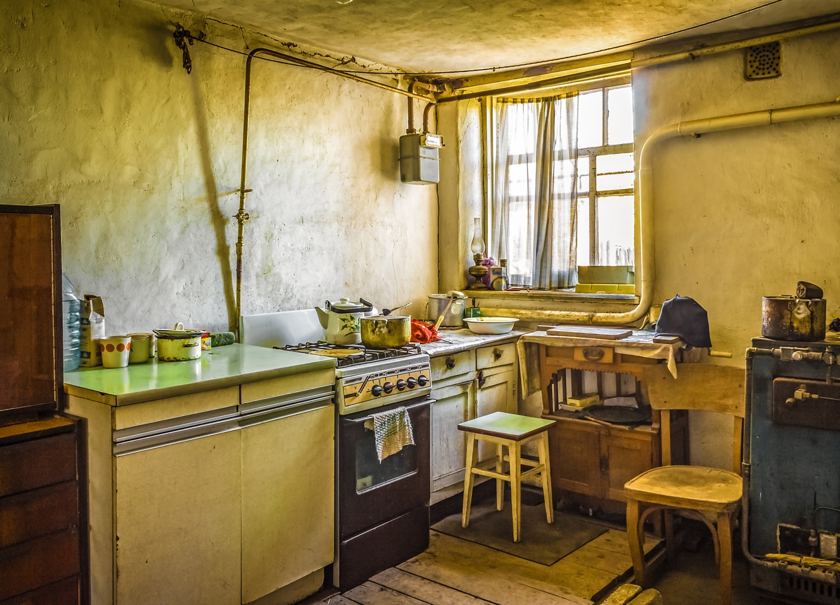
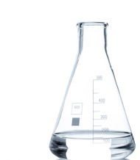
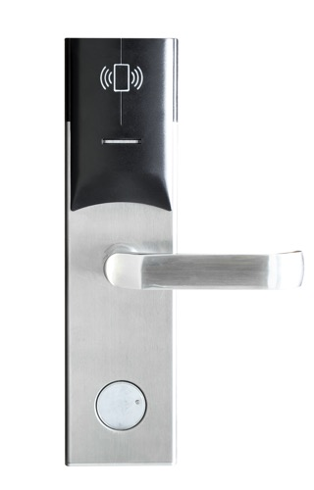
You are locked in.
You have until the end of the lesson to escape.
Here are 3 liquids.
They are different. Pour the right liquid into each tube and the door will unlock.
pH scale
sour or soapy?
B
C
A
open me
2
11
7
ENGAGE
Which liquid goes in each test tube?
© Mastery Science, 2019
Notes:
In this activity students are locked in an escape room. They have to solve two puzzles in order to escape. See the materials required section at the end of the guide for information on how to set up the classroom. Introduce the scenario.

